Slide 1


MODELLING STUDENT SCORES PREDICTION
FARREL PAKSI ADITYA
DATA SERIES 10.0 PROJECT AI & MACHINE LEARNING BY:

Slide 2
ASSIGNMENT
In this assignment, I tried to create a machine learning model to predict students' grades based on the length of their study hours. The data used is analyzed and divided into training data and test data to build a model. The models used are Linear Regression, Decision Tree, and Random Forest. Later the accuracy values ​​of these models will be compared and the best accuracy will be selected.

Slide 3


MACHINE LEARNING WORKFLOW
INPUT DATA + EDA
(EXPLORATORY DATA ANALYSIS)
DATA SPLITTING
(TRAIN SET & TEST SET)
FEATURE ENGINEERING
MODELLING WITH MACHINE LEARNING
PREDICTION RESULT
MODEL EVALUATION

Slide 4
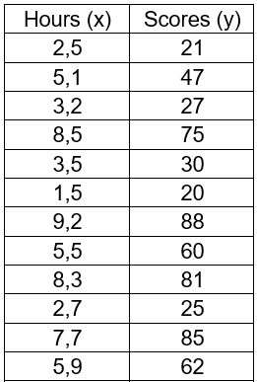
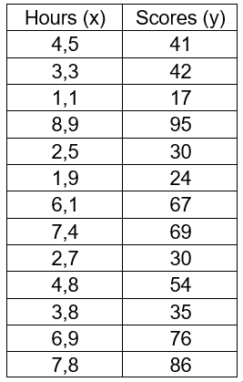
DATASET
DATASET STUDENT_SCORES.XLSX
In the dataset there are 2 variabels: Student Scores & Hours. We will predict Student Scores based on the Hours variabel.

Slide 5



TOOLS & LIBRARY VERSION
TOOLS:
Google Colab for Code Editor
Microsoft Excell for Dataset
Python for Programming Language

Slide 6




TOOLS & LIBRARY VERSION
LIBRARY VERSION:
Pandas version: 2.0.3
Seaborn version: 0.13.1
Numpy version: 1.25.2
Matplotlib version: 3.7.1

Slide 7

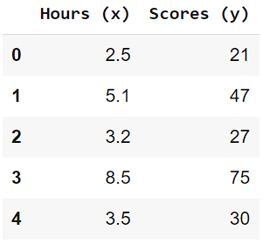
INPUT DATA + EDA
INPUT DATA:
Import or load the dataset with Pandas, Pandas will create a new Dataframe named by data variable. Show 5 rows Dataframe using .head()

Slide 8


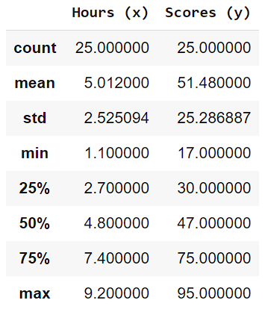
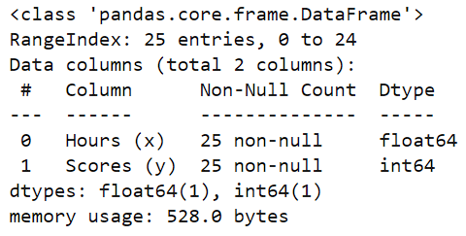
INPUT DATA + EDA
EDA (EXPLORATORY DATA ANALYSIS):
Values of Statistic from Dataframe
Information like Rows & Column in Dataframe

Slide 9
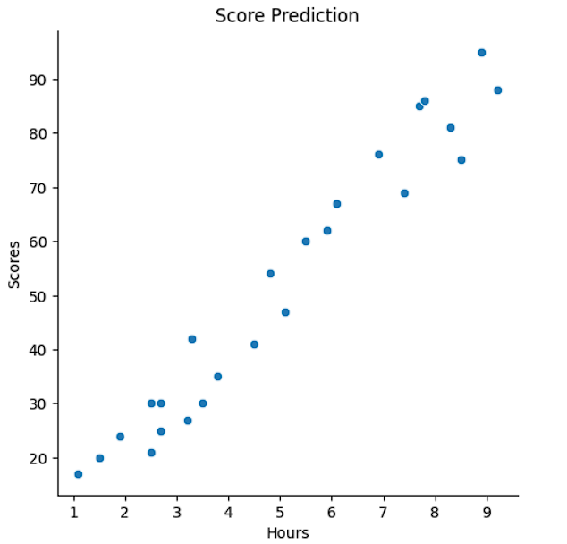
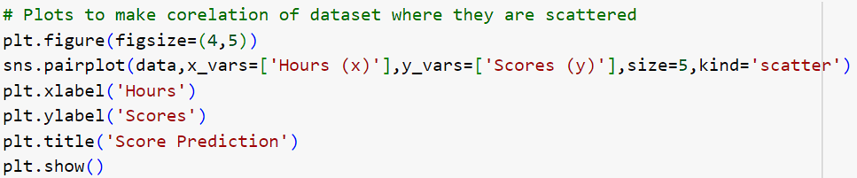
INPUT DATA + EDA
EDA (EXPLORATORY DATA ANALYSIS):
Based on the Plots Corelation, the Score Prediction Plots will increase because the longer the student's study period, the greater the student's score.

Slide 10
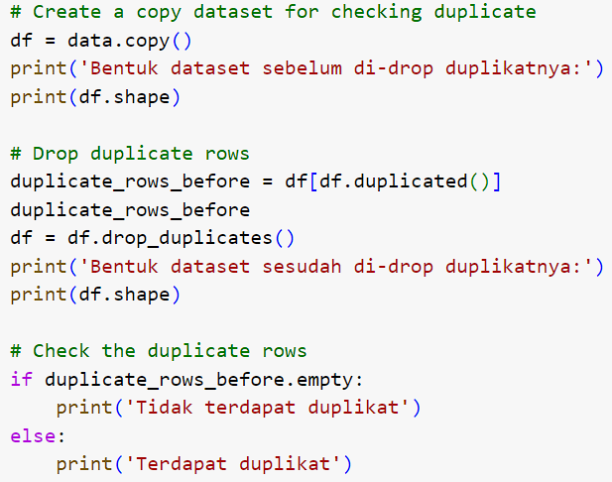
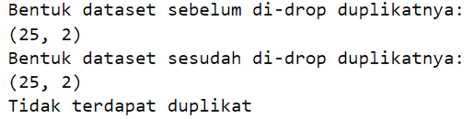
FEATURE ENGINEERING
FEATURE ENGINEERING
Make a copy from Dataframe to check duplicate data. In this case, Dataframe not have duplicate data.

Slide 11
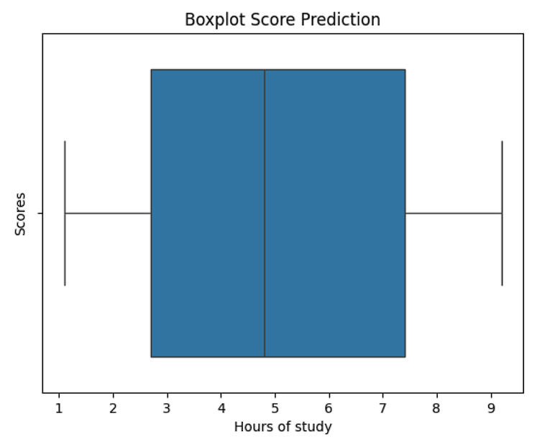

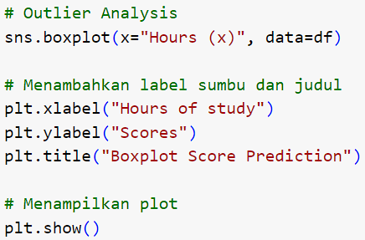

FEATURE ENGINEERING
FEATURE ENGINEERING
From the copy before, then calculate of total null value. In this case, there is no Null Value.
And create Boxplot to check outliers. And then in this case, the Dataframe not have Ouliers.

Slide 12
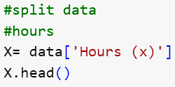


DATA SPLITTING
DATA SPLITTING:
Using library sklearn.model_selection to import module train_test_split
Split Dataframe with Data Train & Data Test
The size of Data Train is 75% and the size of Data Test is 25%

Slide 13
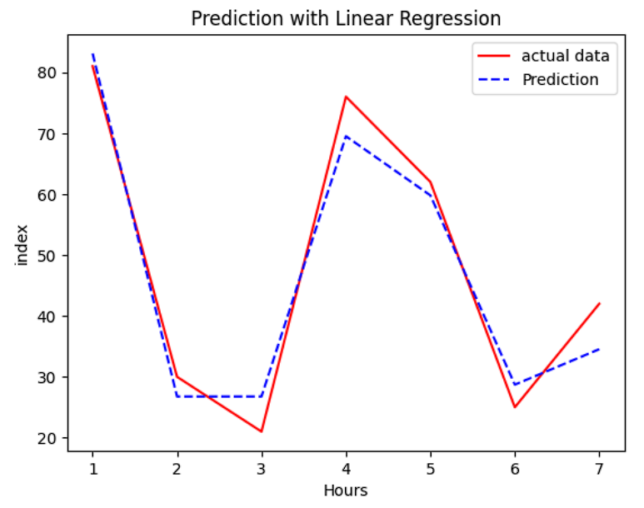



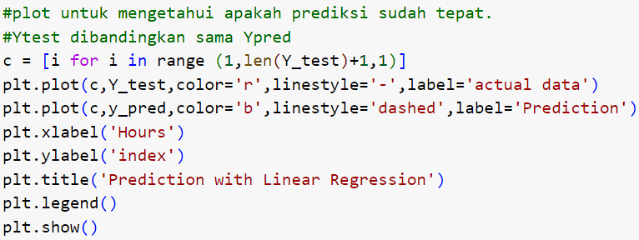
MODELLING WITH MACHINE LEARNING
LINEAR REGRESSION

Slide 14
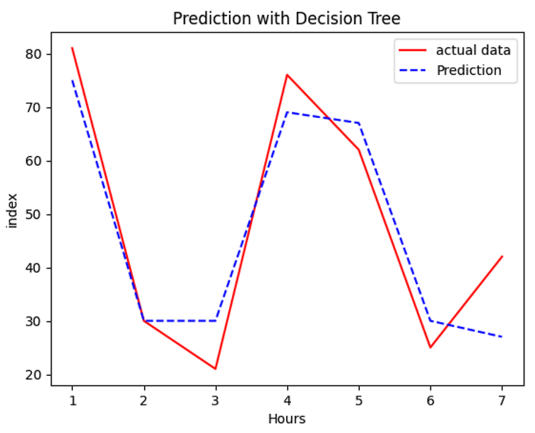

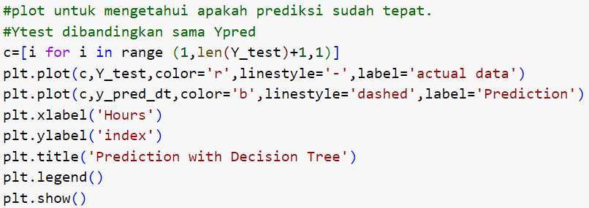
MODELLING WITH MACHINE LEARNING
DECISION TREE

Slide 15
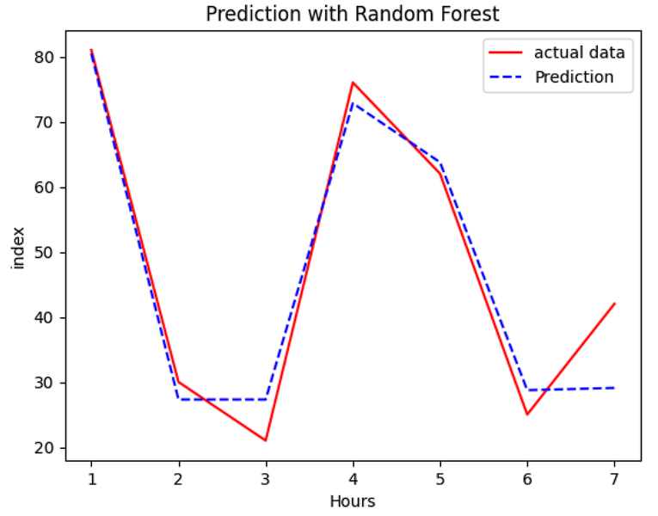

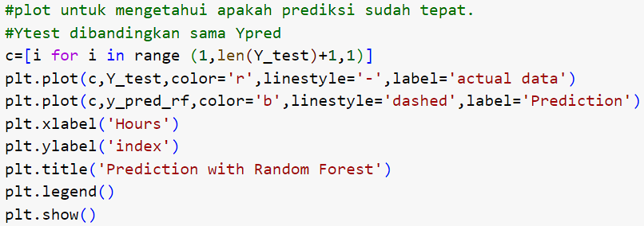
MODELLING WITH MACHINE LEARNING
RANDOM FOREST

Slide 16

MODEL EVALUATION
LINEAR REGRESSION:
Evaluate the model Linear Regression using r Squared.

Slide 17

MODEL EVALUATION
DECISION TREE:
Evaluate the model Decision Tree using r Squared.

Slide 18

MODEL EVALUATION
RANDOM FOREST:
Evaluate the model Random Forest using r Squared.

Slide 19

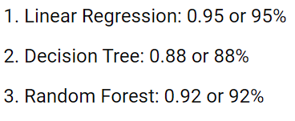

PREDICTION RESULT
COMPARE ALL OF MODEL:
From the comparison of the model evaluation values ​​above, it can be seen that the Linear Regression model has a higher accuracy value than the other models.

Slide 20
EMAIL:
farrelpaksiaditya@gmail.com
INSTAGRAM:
LET’S FIGHT TOGETHER!
_frladtya03
LINKEDIN:
www.linkedin.com/in/farrel-paksi-aditya-4248002a5
PHONE:
+6283815430020

